Slide 1
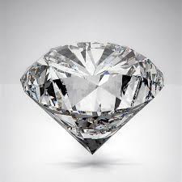

Diamond price prediction ShAI team project
Group 1 Team 4 - Ammar Alhasanat
الحارث بشار الحاج حسين رغد عامر الحلبي علي عمرو علي عبد الله منار محمد سيد

Slide 2
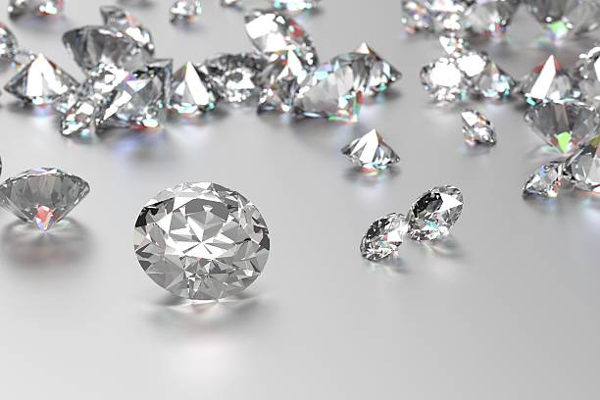
Agenda
Final Results
Model Selection
Data Preprocessing
6
4
Model Fine-tuning
EDA
2
Features Engineering
5
1
3

Slide 3
EDA
Observations:
First thing we did we got the raw data
then get a copy from it to work with,
without touching the original data.
There are no Nulls(missing values) & no Duplicates.
01
04
There are 43152 observations and 11 features (including target).
There are some zeros in (“x"&"y"&"z") columns.
02
05
There are 8 numerical features and 3 categorical ones.
We looked for the outliers in the data and it looks like there are lots of columns that have some outliers.
03
06

Slide 4
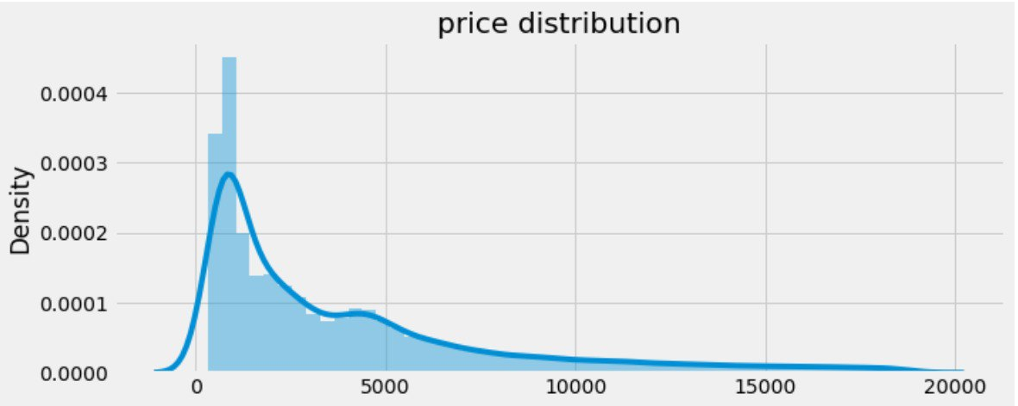

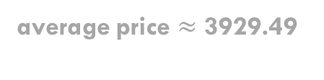


EDA
Average
average price $≈$ 3929.49
Maximum
Minimum
$
$
Maximum price$=$18823.0
Minimum price $=$ 326.0

Slide 5
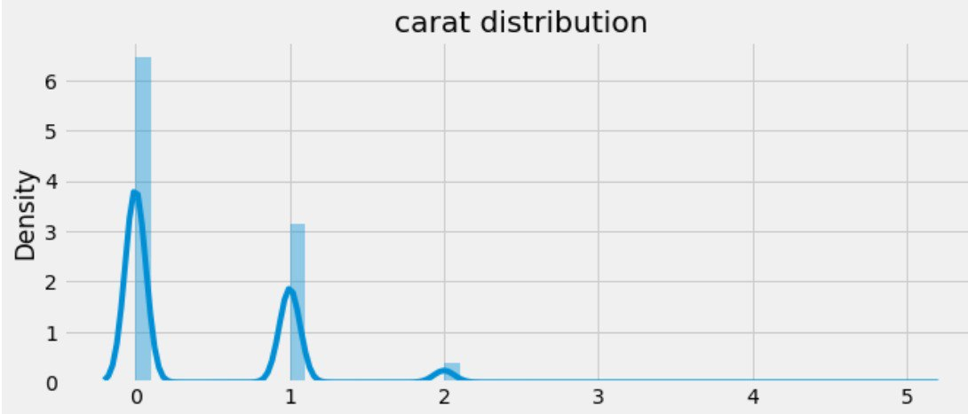

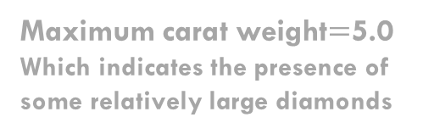
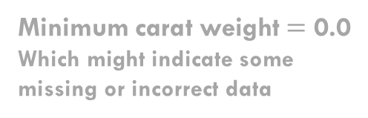
EDA
Average
average carat weight $≈$ 0.395
Maximum
Minimum
Maximum carat weight$=$5.0
Which indicates the presence of some relatively large diamonds
Minimum carat weight $=$ 0.0
Which might indicate some missing or incorrect data

Slide 6
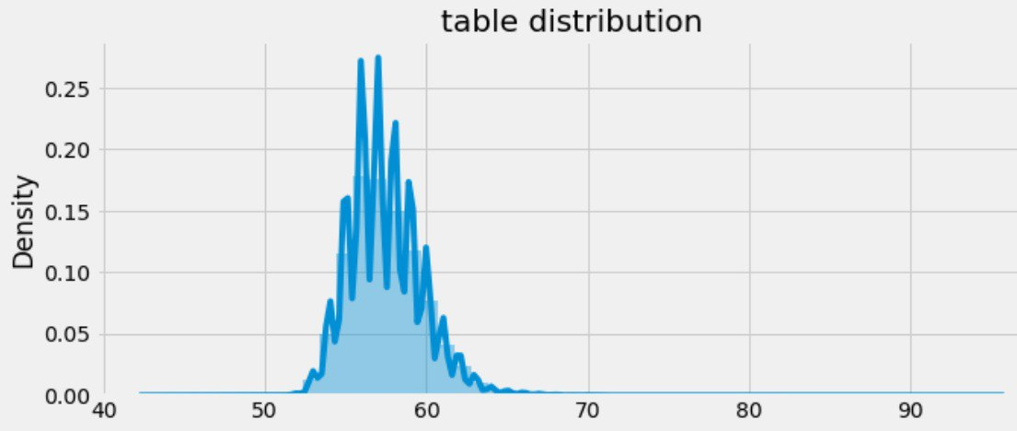



EDA
Average
average t$able≈$ 57.45
Minimum
Minimum table $=$ 43.0
Maximum
Maximum table $=$95.0

Slide 7
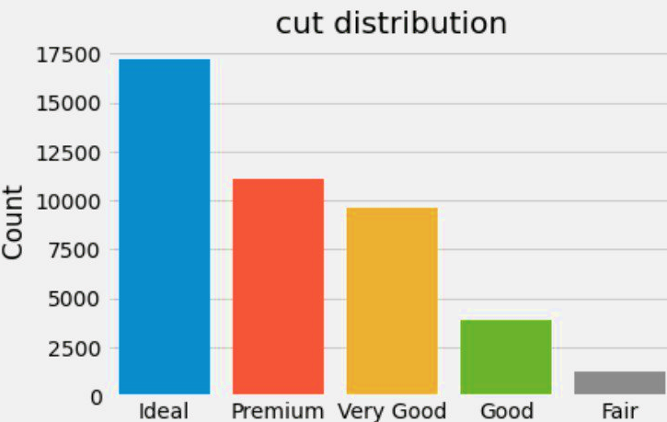
EDA
The most frequent category, with 17,203 diamonds having an idea cut. This suggests that a significant portion of the diamonds in the dataset have been cut to ideal proportions, potentially leading to higher overall quality and value.

Slide 8
EDA
Comes in second place with 11,113 diamonds falling into this category. Although slightly less frequent than the ideal cut, the premium cut still represents a substantial portion of the dataset.

Slide 9
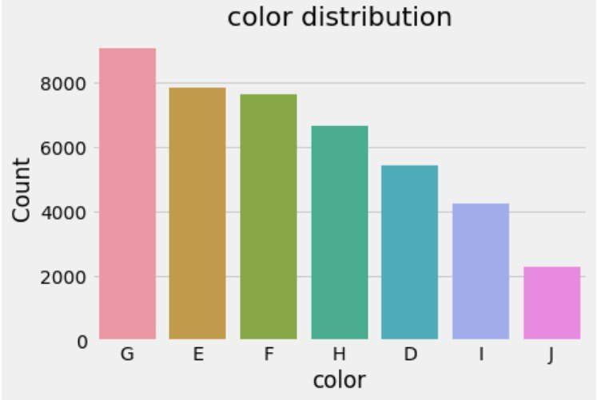
EDA
With 9,060 diamonds. These diamonds are typically near colorless and are considered high quality.

Slide 10
EDA
With 7,832 diamonds are also near colorless and highly valued for their clarity and brilliance.

Slide 11
EDA
The F color grade includes 7,633 diamonds. These diamonds are near colorless and exhibit minimal traces of color, contributing to their visual appeal.

Slide 12
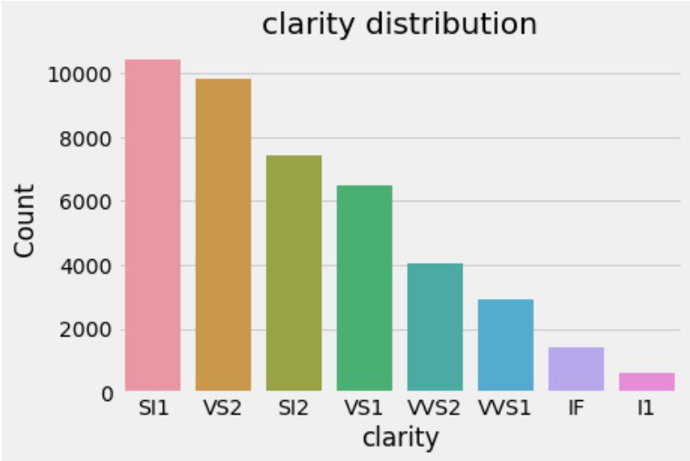
EDA
SI1 (Slightly Included 1): This category has the highest count with 10,428.

Slide 13
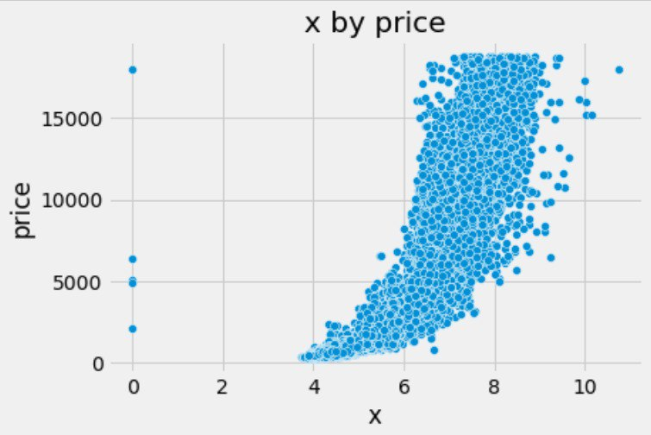
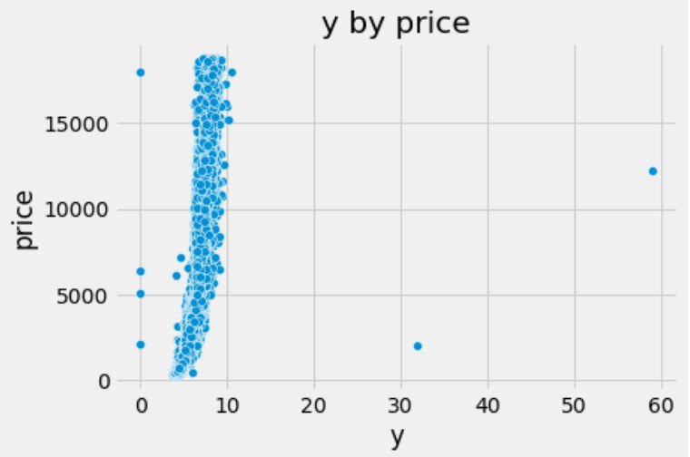
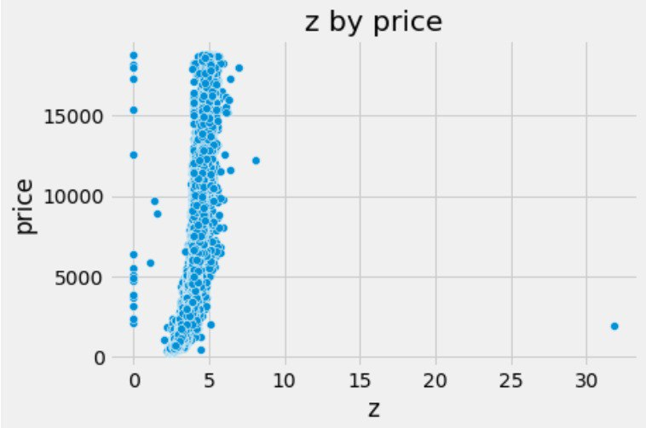
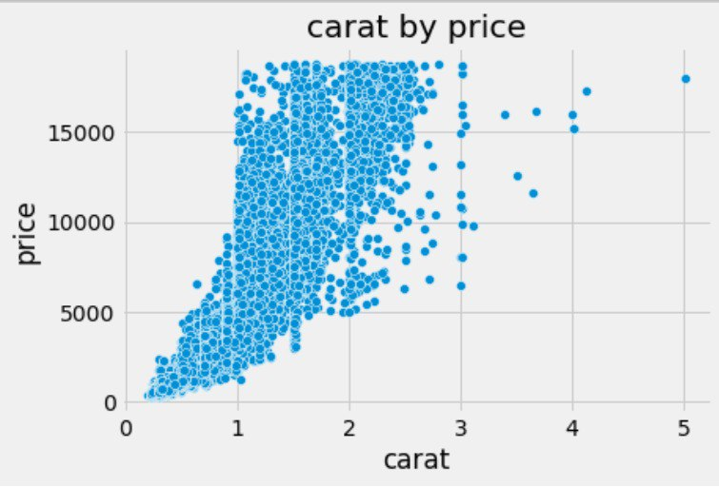
EDA
VS2 (Very Slightly Included 2): there are 9,824 VS2 diamonds. These diamonds have slight inclusions that are difficult to detect without magnification, making them highly desirable.

Slide 14
EDA
Based on the provided information, it seems that the dimensions x, y, and z, which represent the length, width, and depth of the diamonds, respectively, along with the carat weight, have a strongly positive correlation with the price of diamonds. This implies that as the dimensions and weight of the diamonds increase, their prices increase as well.

Slide 15
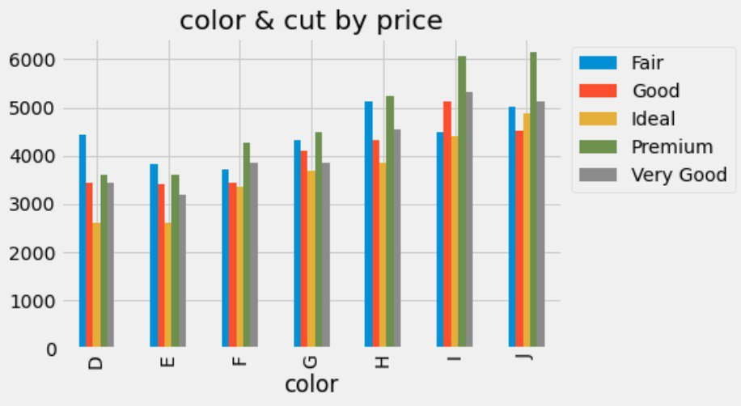
EDA
Interestingly, diamonds with a cut of 'Ideal' tend to have the lowest average price across all color categories, followed by 'Very Good' cuts.

Slide 16

EDA
Interestingly, Within each cut category, diamonds with higher color grades like(D, E) generally have lower average prices compared to those with lower color grades (H, I, J).

Slide 17
Data Preprocessing
01
Splitting the data into 80% train data and 20% test data
We drop the faulty data which is 17 rows having zeros in the (“x"&"y"&"z") columns.
02
We encode the categorical data using ordinal Encoder to ensure considering their order (mapping each unique value with a number)
03

Slide 18
Data Preprocessing
More about outliers handling…..
For the outliers First, we convert all the values to its log value as the log transform one of the best ways to fix the outliers in the data
Outliers
Then we use the IQR to handle the remaining outliers, because the IQR is a robust, effective, simple, and non-parametric method for identifying and handling outliers.

Slide 19
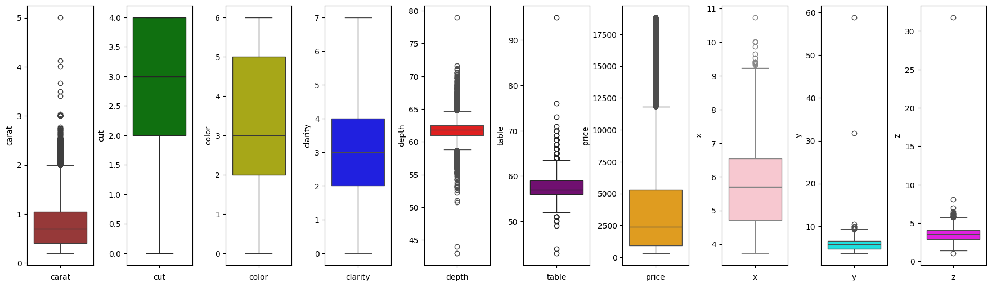
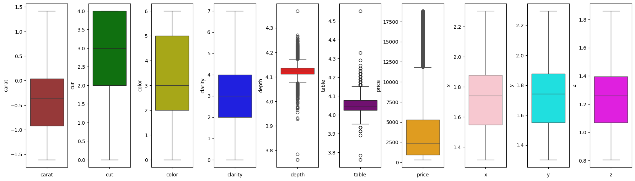
Data Preprocessing
Before
After

Slide 20
Data Preprocessing
Custom Log Transformer:
01
Purpose
Applies a logarithmic transformation followed by standard scaling
04
Methods
__init__(self, with_mean=True):
Initializes StandardScaler.
fit(self, X, y=None):
Returns self (no fitting needed).
transform(self, X, y=None):
Applies np.log to X.
Standardizes log-transformed data with StandardScaler.
inverse_transform(self, X, y=None):
Reverts standard scaling.
Applies np.exp to revert log transformation.
02
Class Structure Inheritance: BaseEstimator, TransformerMixin
03
Useful for preprocessing data with exponential growth patterns.
Ensures features are standardized post-log transformation.

Slide 21
Features Engineering
01
02
04
Table percentage feature
Depth percentage feature
Standard scaling
We make this new feature from the columns: table & x & y & z to help the model train better
We perform standard scaling on the numerical values after the last step to make sure that the test data doesn’t affect the train data by any chance.
We make this new feature from the columns: depth & x & y & z to help the model train better

Slide 22
Model selection
Cross-Validation
Models Evaluated:
Linear Regression, lasso regression, ridge regression
Decision Tree Regressor
Random Forest
SVR
Gradient Boosting Regressor
XGBoost
Evaluation Method: 10-fold Cross-Validation
Criterion: Root Mean Squared Error (RMSE)
Best Models: Random Forest Regressor and XGBoost
Results:
Linear Regression: Mean RMSE = 970.89, Std RMSE = 76.99
Lasso Regression: Mean RMSE = 970
Ridge Regression: Mean RMSE = 970
Decision Tree Regressor: Mean RMSE = 758.92, Std RMSE = 25.39
Random Forest: Mean RMSE = 553.66, Std RMSE = 18.58
SVR: Mean RMSE = 575.17, Std RMSE = 24.48
Gradient Boosting Regressor: Mean RMSE = 617.06, Std RMSE = 22.71
XGBoost: Mean RMSE = 550.12, Std RMSE = 19.97
Conclusion: Selection based on lowest mean RMSE via cross-validation.

Slide 23
Model Fine-tuning
Fine-Tuning
Models Tuned: Random Forest and XGBoost
Method: Randomized Search Cross-Validation (n_iter=50)
Random Forest:
RMSE: 545
Params: {'n_estimators': 166, 'max_features':13}
XGBoost:
RMSE: 522
Params: {'n_estimators': 108}

Slide 24
Final Results
Train the Selected Model on Full Dataset and Refine
Model: Random Forest
Refinement:
RMSE: 550.39
Params: {'n_estimators': 158, 'max_features': 10}
Prediction on Submission Dataset
Final Prediction:
RMSE: 531

Slide 25

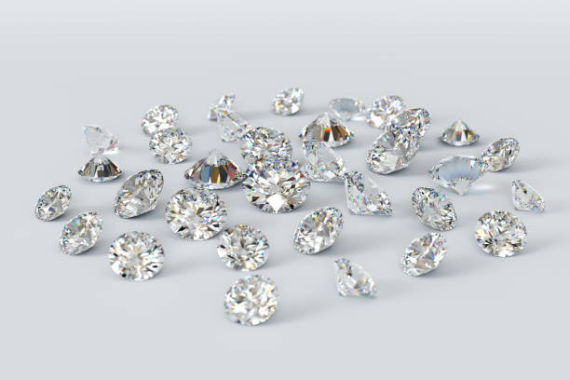

T H A N K S F O R W A T C H I N G
Credits to
for the template

